Slide 1
Northwind Dashboard & Analysis
Rakha Kahansa Putra
Kelompok 6
DSLS 2023 – Mini Project DE

Slide 2
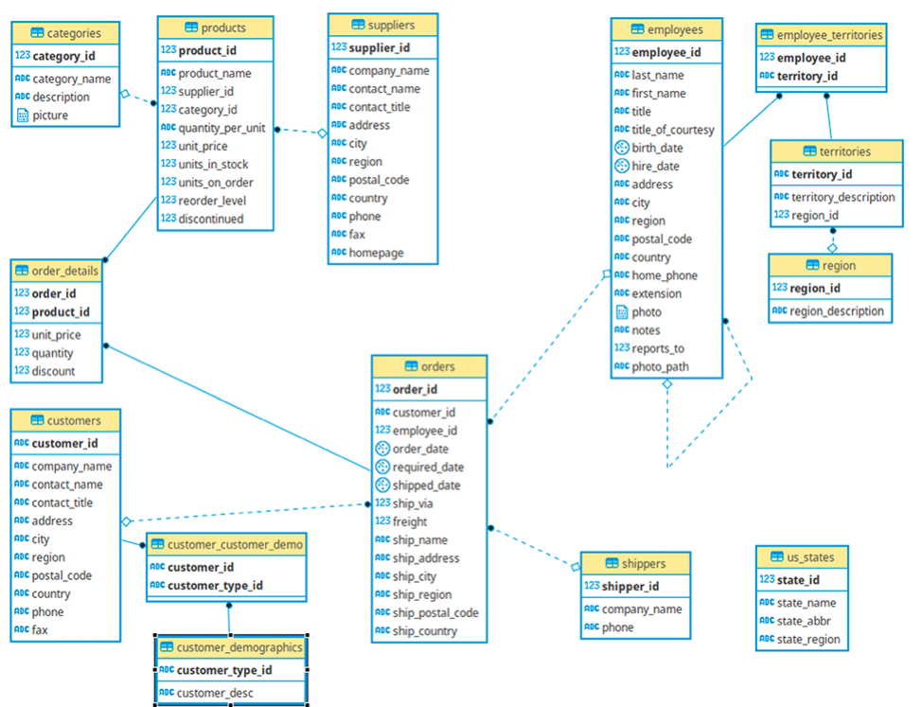
Background and Database
The Northwind database is a sample database created by Microsoft that contains the sales data for a fictitious company called “Northwind Traders,” which imports and exports specialty foods from around the world.
Creating a dashboard for the company can help businesses make data-driven decisions that improve sales performance, inventory management, customer service, and overall efficiency.

Slide 3
Benefits and Business Goals
Business Goals
Benefits
Improve sales performance by analyzing sales data and identifying trends in sales.
Streamline inventory management by providing real-time information about inventory levels.
Enhance customer service by analyzing customer data and tailoring marketing and customer service strategies.
Increase efficiency by providing a centralized location for accessing and analyzing data.
Provides an easy-to-use interface for visualizing and analyzing data.
Displays important information and KPIs in easily understandable format.
Helps managers and decision-makers make informed decisions based on real-time data and analytics.
Allows for the identification of trends and patterns in sales, inventory, and customer data.

Slide 4



Pages and Filters
There are 4 Filters in each pages:
Categories & Product Name
Countries & Cities
Employee Title and Name
Date Picker
There are 3 Pages for the management:
Overview
Product
Region

Slide 5
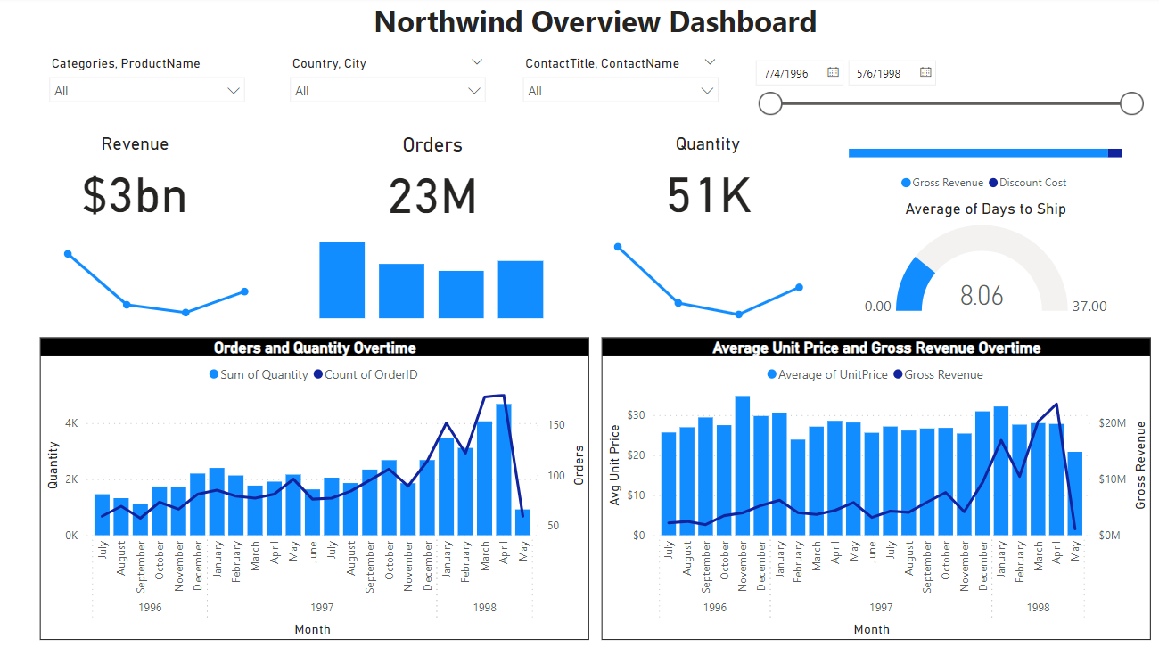
Overview Dashboard Interface
The Overview page is a high-level view of the company's performance and key performance indicators (KPIs).
It provides view of the company's revenue, sales growth, and Average days to ship allowing decision-makers to quickly assess the company's overall performance.
Dashboard also include Sales Growth and Revenue Trend Overtime.

Slide 6
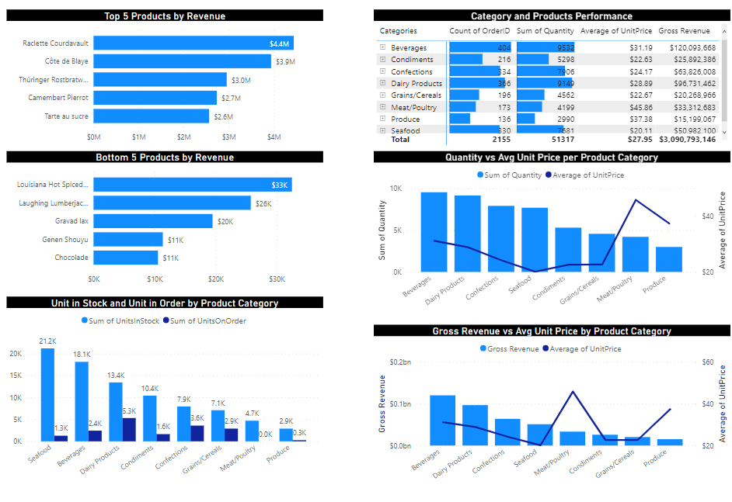
Product Dashboard Interface
The product page focuses on individual products and their performance.
It provides a detailed analysis of the company's product sales, allowing decision-makers to identify top and bottom selling products, product trends of orders and revenue, and Unit in stock/order for each products.
This might help management to sees area for improvement on product levels.

Slide 7
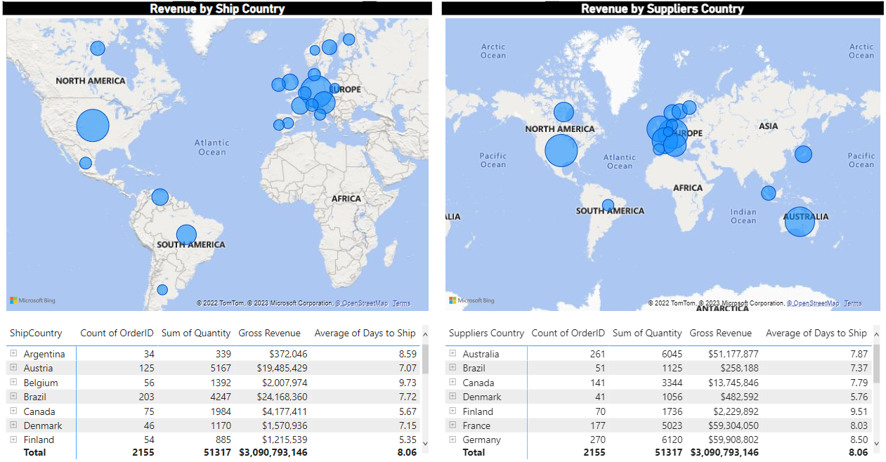
Region Dashboard Interface
The region page focuses on the company's sales performance in different regions.
It provides a detailed analysis of sales by region, allowing decision-makers to identify regions that are performing well and regions that may need improvement.
The page may also include a map or other visualizations to help decision-makers quickly identify geographic trends.

Slide 8
Why Use Certain Charts?

Slide 9
Filters & Cards
Dropdown List
Allows users to quickly and easily filter data to find the information that is most relevant to their needs.
Date Slicer
Allows users to slide or just text on the box easily for preferred time period
Cards
allows for the easy and concise display of key metrics or KPIs.

Slide 10
Sample Chart
Clustered Coloumn
Line & Clustered Coloumn Charts
Allows to show comparison clearly on product levels on respective variables.
Allows for easy visualization and comparison of multiple data trends over time and across different product categories

Slide 11
Sample Chart
Table
Maps
Allows for a comprehensive view of multiple KPI Data and its underlying details across region/products.
Allows for the easy visualization and analysis of data based on geographic location.

Slide 12
Northwind Analysis

Slide 13
Levels of Analysis & Business Value
Discount
Effects of Discount on Customer Order
How to maximize Profits through Discount
Product
Products Profitability Analysis
Price Over Quantity per Product Category
Region
Customer Region Effects on Sales
Supplier Region Effects on Sales

Slide 14
Executive Summary
Discount statistically increase Quantity of Orders
Profitability have good correlation with Average Unit Price
Biggest Customers is USA & Biggest Supplier is Germany and France
Some Action Needs to be Taken for Some Product Category

Slide 15
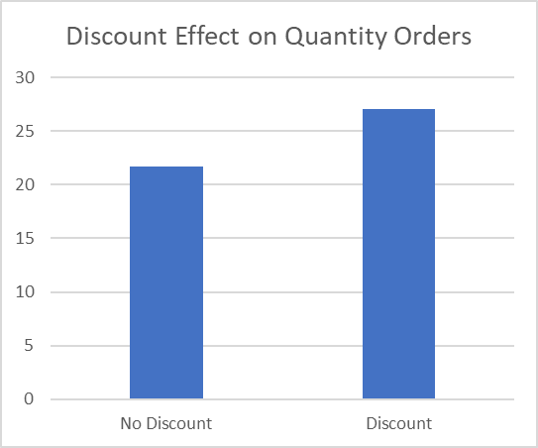
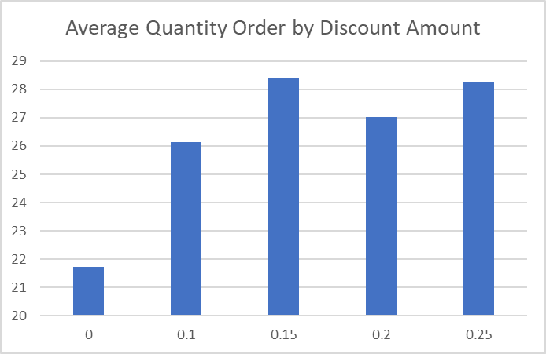
Discount Effect on Quantity Orders
Putting Discount statistically increase Quantity of Orders.
Quantity of Orders with Discount increase 24.8% Relatively compared to No Discount
Discount 15% - 25% is the optimum range to increase Quantity Order

Slide 16
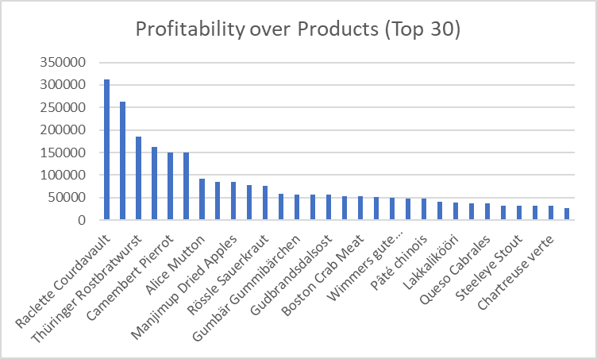
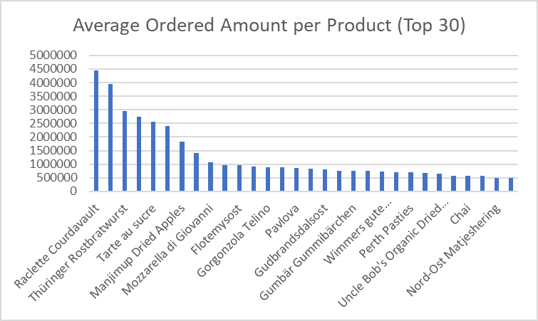
Most Profitable Products
Profitability have good correlation with Higher Average Unit Price

Slide 17
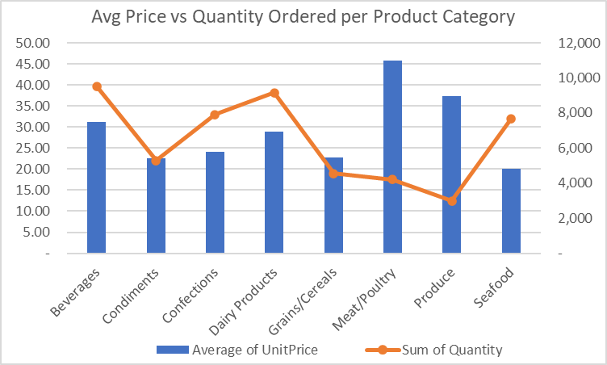
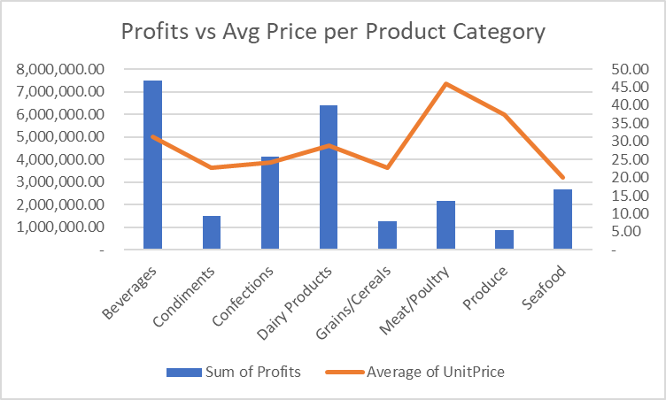
Product Category Findings
Meat/Poultry & Produce low quantity orders due to higher price compare to other category
Seafood has low profitability even with high quantity of orders. This is due to Seafood has low average of unit price

Slide 18
Where to put the Discount?
Increase Unit Price in Seafood -> Increase Profitability. Because from quantity ordered, seafood seems have a high demand.
Putting discount on this Meat/Poultry & Produce -> increase quantity orders -> higher profitability

Slide 19
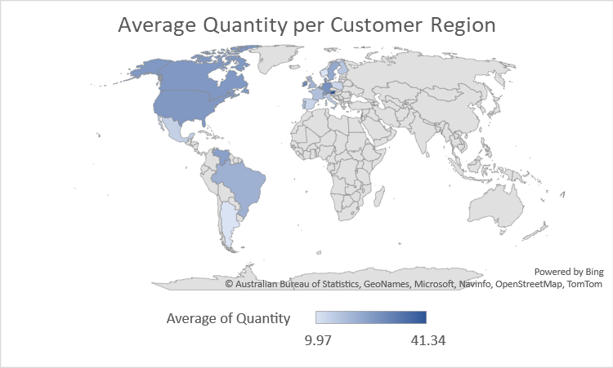
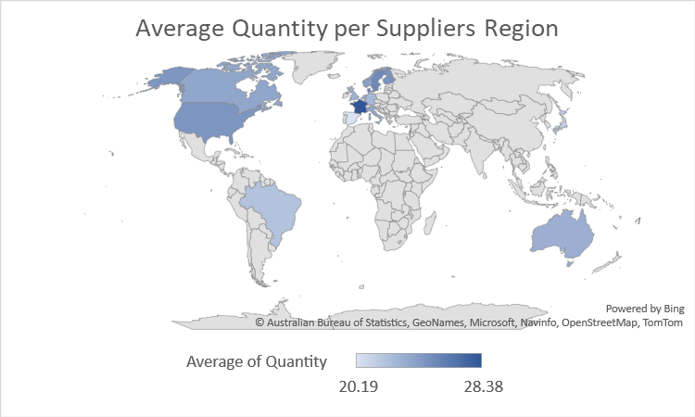
Quantity on Customer and Supplier Region

Slide 20
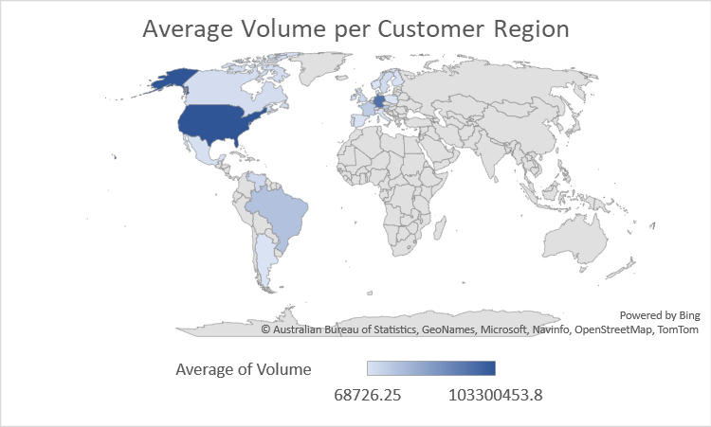
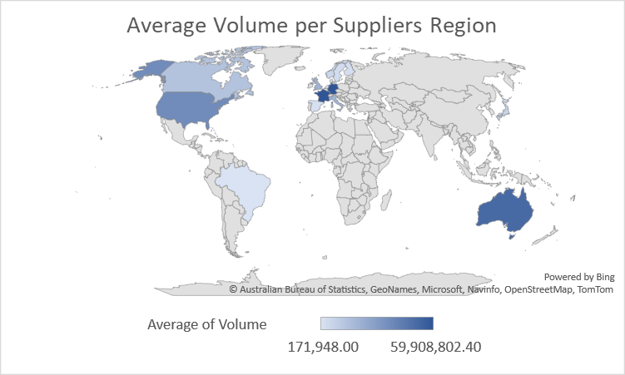
Volume Sales on Customer and Supplier Region
Biggest Customer is from North America (USA)
Biggest Supplier is from West Europe (France & Germany)
Australia is the only country that supplies without having any order

Slide 21
Business Recommendation
Give Discount in Meat/Poultry & Produce Product
Increase Quantity Order and Boost Profitability
Give 15% - 25% Discounts on Segments Needed
Increase Quantity Order without hurting Profitability
Increase Price Unit for Seafood
Increase Profitability since Quantity is already high
Try to find markets on Countries that only Supplies.
New Opportunity in Selling New Products and Boost Volume Sales
Legends:
Action
Expected Impact

